Slide 1





Eliminating Left Recursion From SDT's
No grammar with left recursion can be parsed deterministically top-down.
When transforming the grammar, treat the actions as if they were terminal symbols
The "trick" for eliminating left recursion is to take two productions
replace them by productions
Consider the following E-productions from an SDT for translating infix expressions into postfix notation:
If we apply the standard transformation to E, the remainder of the left-recursive production is
Introduce R as new Nonterminal:

Slide 2

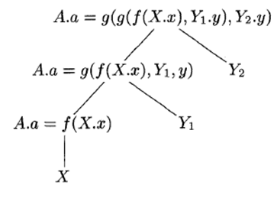
Syntax Directed Translation for Postfix SDT
Here, A.a is the synthesized attribute of left-recursive nonterminal A, and X and Y are single grammar symbols with synthesized attributes X.x and Y.y

Slide 3
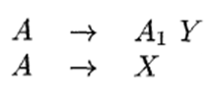

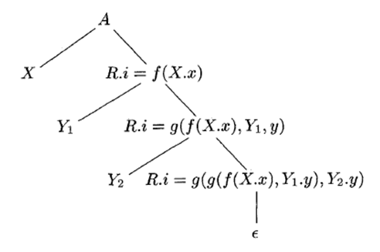

Eliminating left recursion from a postfix SDT
Annotated Parse Tree
Turn the underlying grammar into
SDT for L-attributed Definition

Slide 4
SDT's for L-Attributed Definitions
The rules for turning an L-attributed SDD into an SDT are as follows:
1. Embed the action that computes the inherited attributes for a nonterminal A immediately before that occurrence of A in the body of the production. If several inherited attributes for A depend on one another in an acyclic fashion, order the evaluation of attributes so that those needed first are computed first.
2. Place the actions that compute a synthesized attribute for the head of a production at the end of the body of that production.

Slide 5
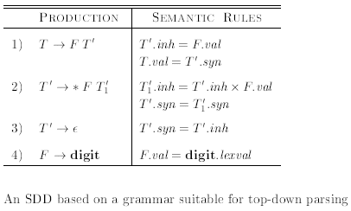
SDT's for L-Attributed Definitions- Example
SDT
T-> F {T’.inh=F.val;} T’ {T.val=T’.syn;}
T’->*F { T1’.inh=T’.inh*F.val;} T1’ {T’.syn=T1’.syn;}
T’->ε {T’.syn=T’.inh;}
F-> digit {F.val=digit.lexval;}

Slide 6
Convert the given L-attributed SDD into SDT
Production | Semantic Rules
D->B D’ | D.val=D’.syn D’.inh=B.val
D’->B D1’ | D1’.inh=D’.inh*2+B.val D’.syn=D1’.syn
D’->ε | D’.syn=D’.inh
B->0 | B.val=0
B->1 | B.val=1

Slide 7
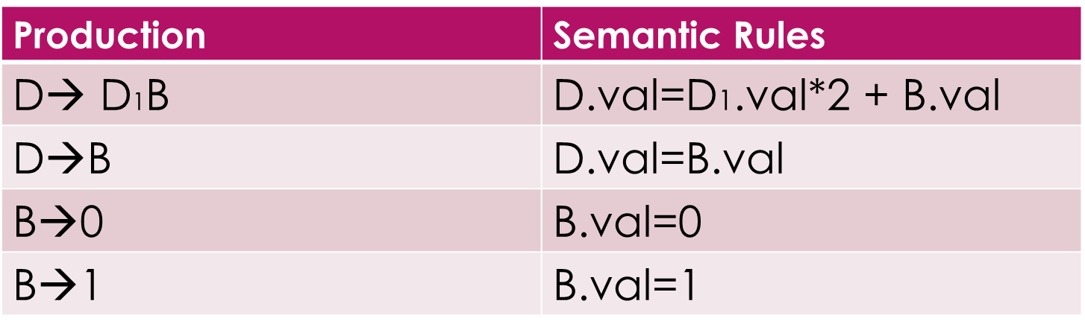
Tutorial Questions
1. Parser Stack Implementation for the Postfix SDT for input string 110

Slide 8
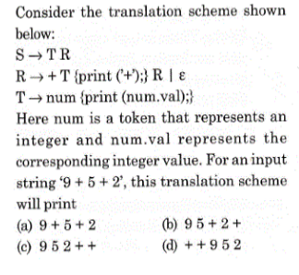
Tutorial Questions
2. Write a S-Attributed definition to compute expression(&&, ||, !)
G: E->E||T | T
T->T&&F | F
F->!E | id
3.

Slide 9
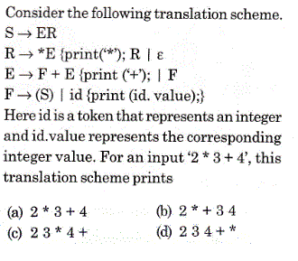
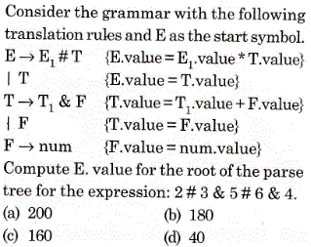
Tutorial Questions
4.
5.

Slide 10
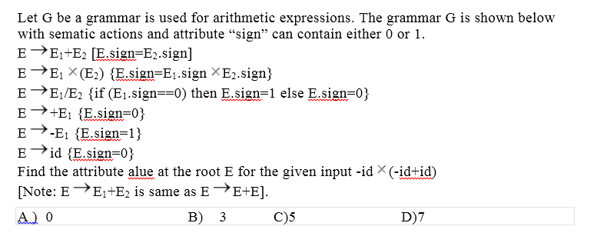
Tutorial Questions
6.

Slide 11
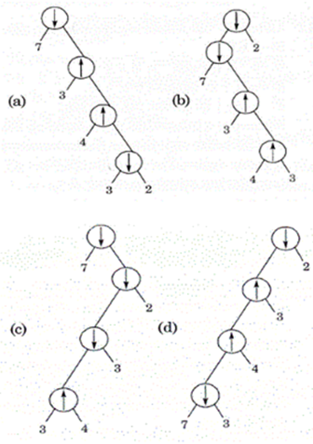
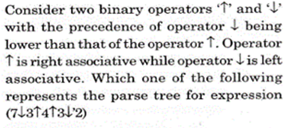
Tutorial Questions
7.

Slide 12
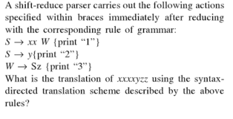

Tutorial Questions
8.

Slide 13
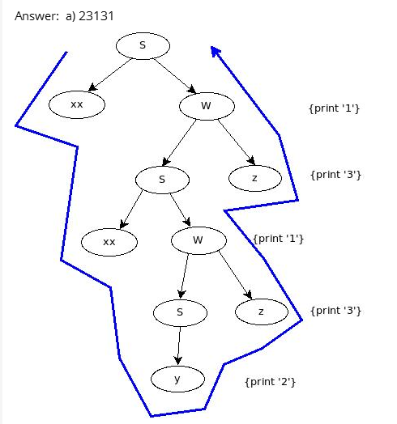
Solution

